Slide 1
Click Title
Junior Cycle
Information for 3rdd Year Parents
Christ King Girls Secondary School

Slide 2
Junior Cert Results 2019

Slide 3
One Subject’s Journey
1
2
Check In
3
Check In
Check In
Transition from
Primary School
First Year
Second Year
2^{nd Year}
^{Classroom-Based Assessment}
Third Year
^{3rd Year}
^{Classroom-Based Assessment}
Final
Assessment
Ongoing Assessment
Ongoing Assessment
Ongoing assessment that supports student learning
Assessment Task
10%

Slide 4
Ensuring Quality
Schools will organise “Subject Learning and Assessment Review” meetings
Teachers will compare their assessment of students’ work and ensure a common approach across the school
CPD will be provided for teachers to ensure that the Classroom-Based Assessments align to a national standard
Exemplars of work are available online
Features of quality are provided in the subject specification

Slide 5
Reporting
Reporting will happen in first, second and third-year
First-year reporting will focus on student learning and self-development
Second and third-year reporting will include the school-based components that will form part of the Junior Cycle Profile of Achievement (CBAs)
The NCCA will develop guidelines for providing these reports to students and parents

Slide 6
State Examinations
Distinction
Higher Merit
Merit
Achieved
Partially Achieved
Not Graded
Classroom-Based Assessments
Exceptional
Above expectations
In line with expectations
Yet to meet expectations
Not reported
Notes:
Distinction≥ 90 to 100Higher Merit≥ 75 and < 90Merit≥ 55 and < 75Achieved≥ 40 and < 55Partially Achieved≥ 20 and < 40Not Graded (NG)≥ 0 and < 20

Slide 7
Steps towards the Junior Cycle Profile of Achievement
Classroom-Based Assessments of subjects will be completed in second and third-year
Students will sit written SEC prepared examinations in June of third-year for subjects
Schools will report on student engagement and participation in the Other Areas of Learning section of the JCPA over the course of Junior Cycle

Slide 8
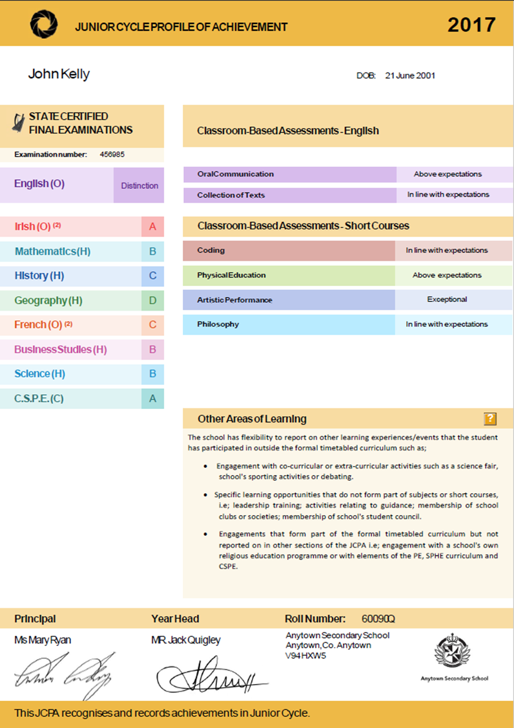
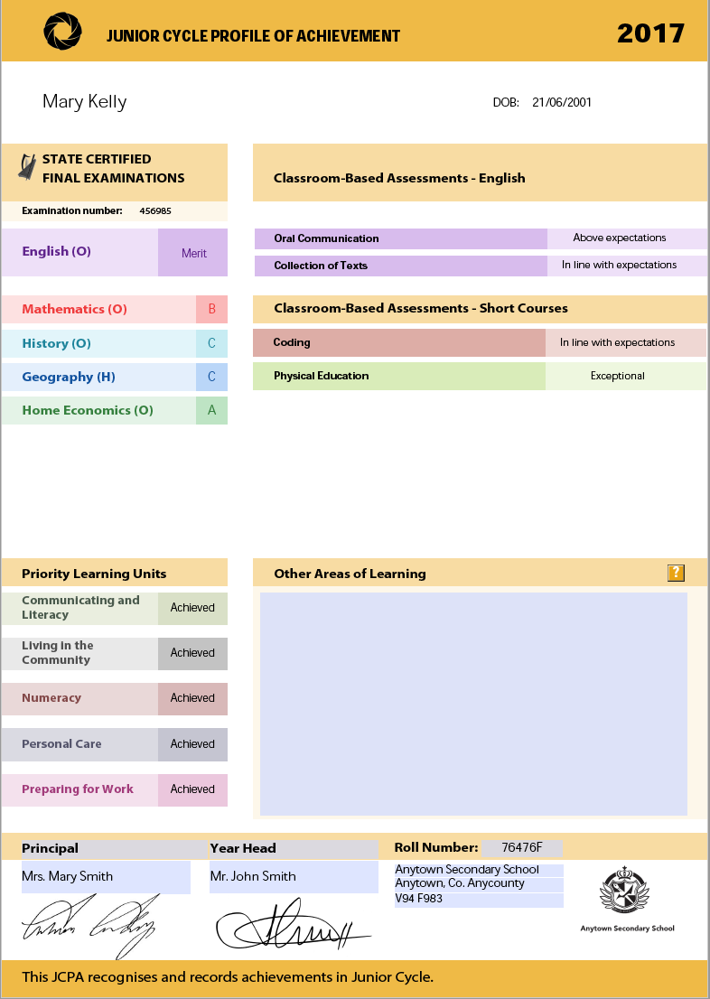

Slide 9
Subjects

Slide 10
Other Areas of Learning
Done with class teacher
Learning Log
Signed by you
Done by Christmas
Emailed to Junior Cycle coordinator

Slide 11
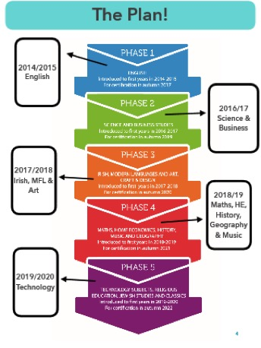
Current 2nd Years | Current 3rd Years
English Science Business Irish Modern Foreign Languages Art Maths History Georaphy Home Economics Music | English Science Business Irish Modern Foreign Languages Art

