Slide 1
Click Title
Junior Cycle
Information for 2nd Year Parents
Christ King Girls Secondary School

Slide 2
Learning Intentions
1. A common understanding of what Junior Cycle means for our students
2. Improve our understanding of assessment structures at Junior Cycle

Slide 3
What is the purpose of education in Junior Cycle?
Help students become better learners and develop a love of learning
Provide a solid foundation for further study
To develop skills for learning and life
To support learning through improved reporting to both students and parents

Slide 4
One Subject’s Journey
1
2
Check In
3
Check In
Check In
Transition from
Primary School
First Year
Second Year
2^{nd Year}
^{Classroom-Based Assessment}
Third Year
^{3rd Year}
^{Classroom-Based Assessment}
Final
Assessment
Ongoing Assessment
Ongoing Assessment
Ongoing assessment that supports student learning
Assessment Task
10%

Slide 5
Classroom-Based Assessment Example:

Slide 6
Ensuring Quality
Schools will organise “Subject Learning and Assessment Review” meetings
Teachers will compare their assessment of students’ work and ensure a common approach across the school
CPD will be provided for teachers to ensure that the Classroom-Based Assessments align to a national standard
Exemplars of work are available online
Features of quality are provided in the subject specification

Slide 7
Reporting
Reporting will happen in first, second and third-year
First-year reporting will focus on student learning and self-development
Second and third-year reporting will include the school-based components that will form part of the Junior Cycle Profile of Achievement (CBAs)
The NCCA will develop guidelines for providing these reports to students and parents

Slide 8
State Examinations
Distinction
Higher Merit
Merit
Achieved
Partially Achieved
Not Graded
Classroom-Based Assessments
Exceptional
Above expectations
In line with expectations
Yet to meet expectations
Not reported
Notes:
Distinction≥ 90 to 100Higher Merit≥ 75 and < 90Merit≥ 55 and < 75Achieved≥ 40 and < 55Partially Achieved≥ 20 and < 40Not Graded (NG)≥ 0 and < 20

Slide 9
Steps towards the Junior Cycle Profile of Achievement
Classroom-Based Assessments of subjects will be completed in second and third-year
Students will sit written SEC prepared examinations in June of third-year for subjects
Schools will report on student engagement and participation in the Other Areas of Learning section of the JCPA over the course of Junior Cycle

Slide 10
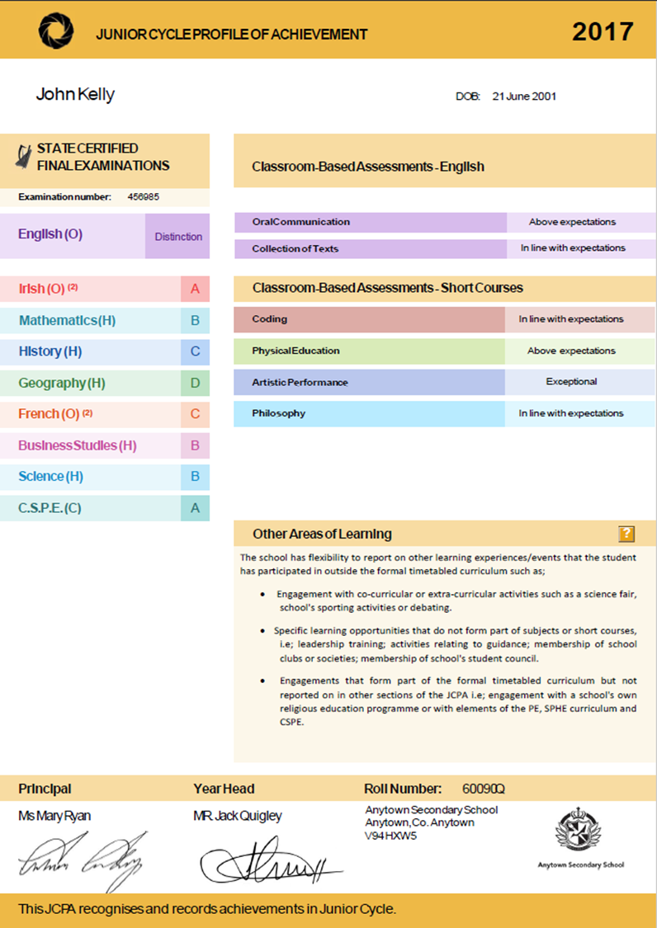
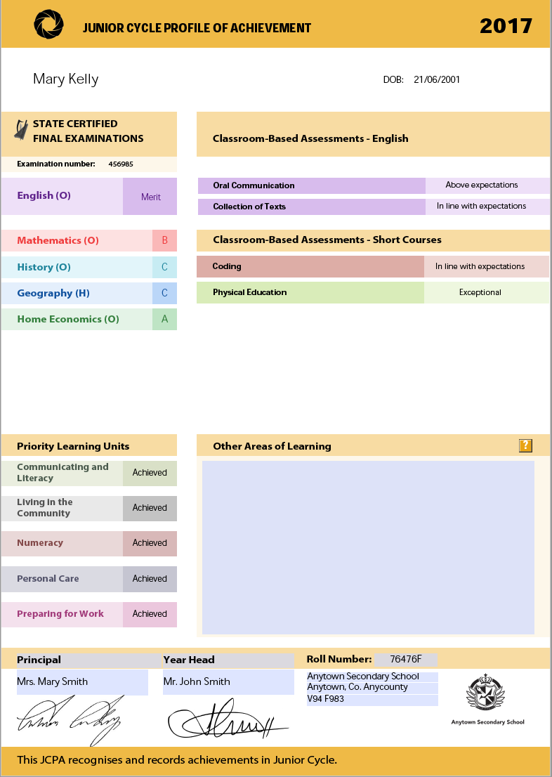

Slide 11
Subjects

Slide 12
Other Areas of Learning

Slide 13
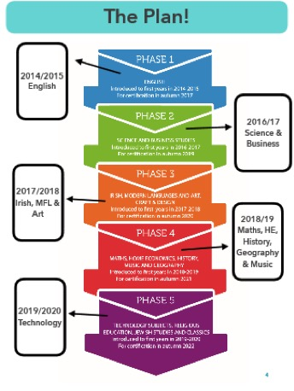
Current 2nd Years | Current 3rd Years
English Science Business Irish Modern Foreign Languages Art Maths History Georaphy Home Economics Music | English Science Business Irish Modern Foreign Languages Art

Slide 14
What is the purpose of education in Junior Cycle?
Help students become better learners and develop a love of learning
Provide a solid foundation for further study
To develop skills for learning and life
To support learning through improved reporting to both students and parents

